Slide 1

CINF103 Fundamentos de Inteligencia Artificial
Segundo Semestre 2023

Slide 2
Algunos Hitos de la IA

Slide 3
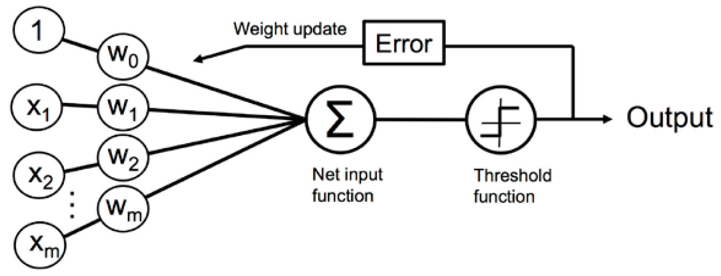
El perceptrón (McCullogh & Pitts, 1943; Rosenblatt, 1957)
Perceptrón
Rosenblatt, F. (1960). Perceptron simulation experiments. Proceedings of the IRE, 48(3), 301-309.
McCulloch, W; Pitts, W (1943). "A Logical Calculus of Ideas Immanent in Nervous Activity". Bulletin of Mathematical Biophysics. 5: 115–133
Rosenblatt, F. (1958). The perceptron: a probabilistic model for information storage and organization in the brain. Psychological review, 65(6), 386.

Slide 4
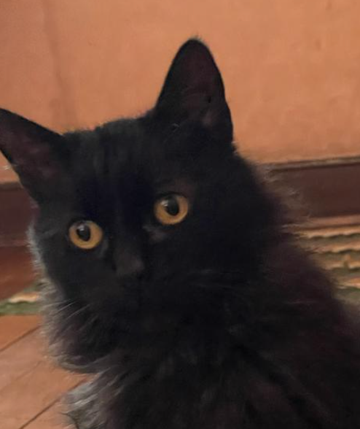
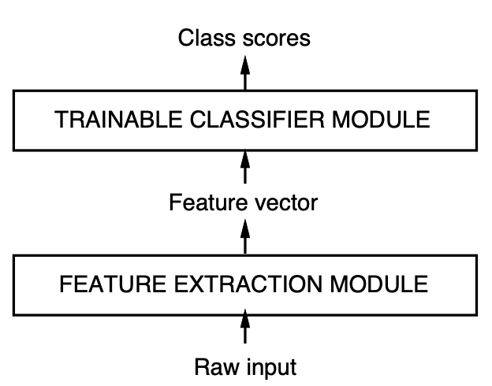
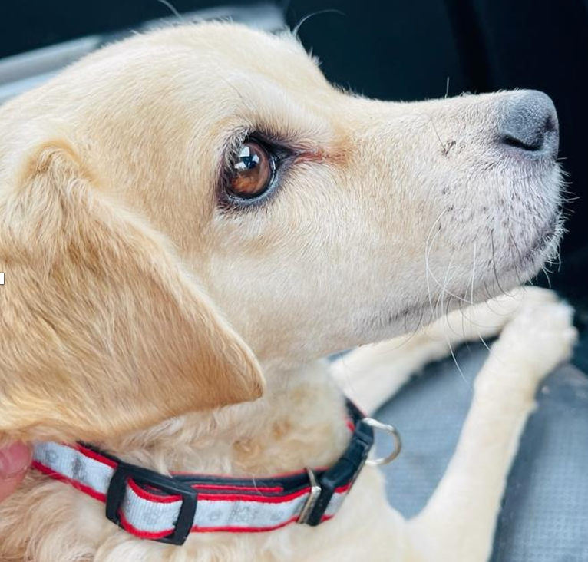
Reconocimiento de Patrones
Cat
Dog

Slide 5
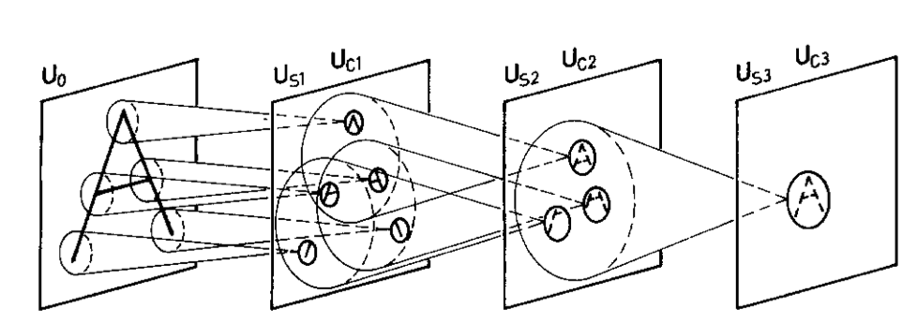
Neocognitron (Fukushima, 1982, 1988)
Fukushima, K., & Miyake, S. (1982). Neocognitron: A self-organizing neural network model for a mechanism of visual pattern recognition. In Competition and cooperation in neural nets (pp. 267-285). Springer, Berlin, Heidelberg.

Slide 6
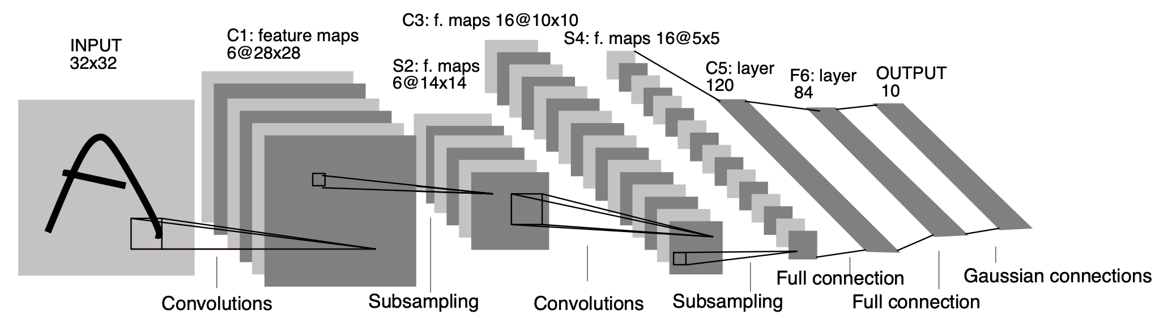
Convolutional Neural Network (LeCun, 1998)
LeCun, Y., Bottou, L., Bengio, Y., & Haffner, P. (1998). Gradient-based learning applied to document recognition. Proceedings of the IEEE, 86(11), 2278-2324

Slide 7
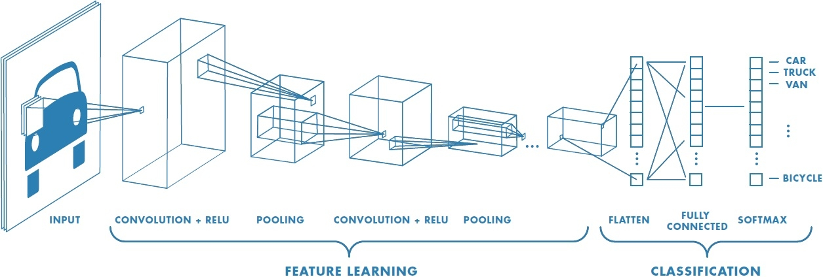
Convolutional Neural Network

Slide 8
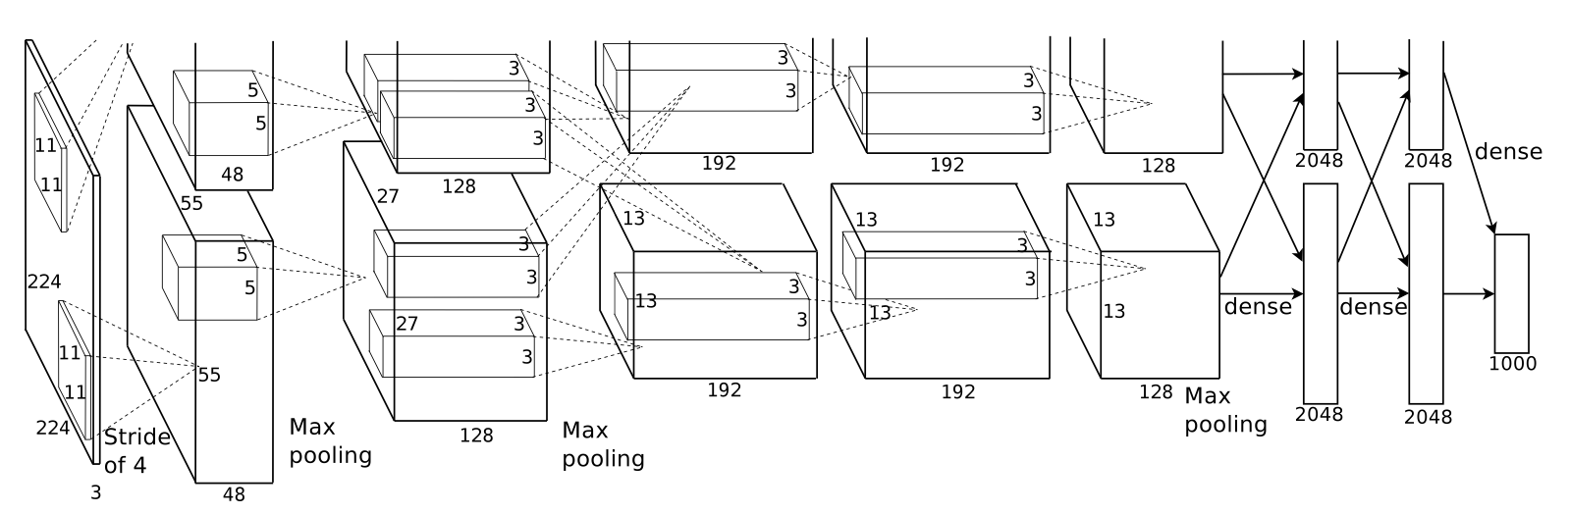
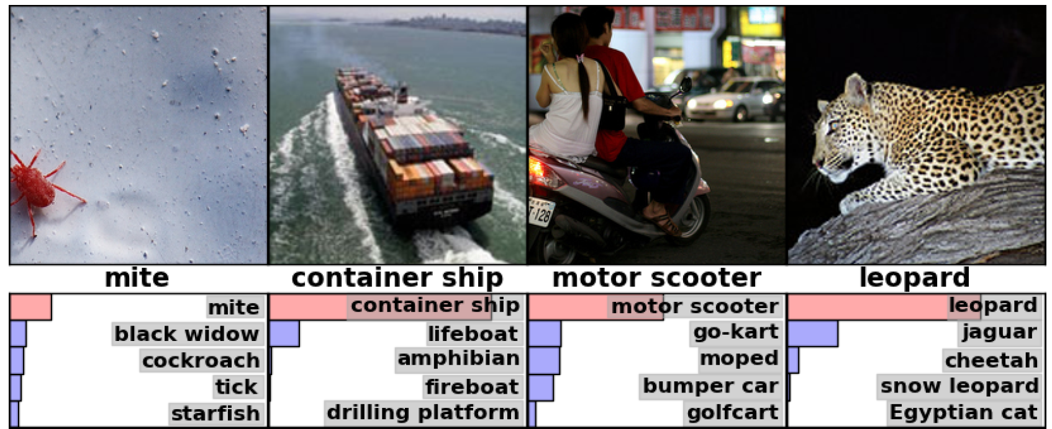
Imagenet (Krizhevsky, 2012)
Krizhevsky, A., Sutskever, I., & Hinton, G. E. (2012). Imagenet classification with deep convolutional neural networks. Advances in neural information processing systems, 25.

Slide 9
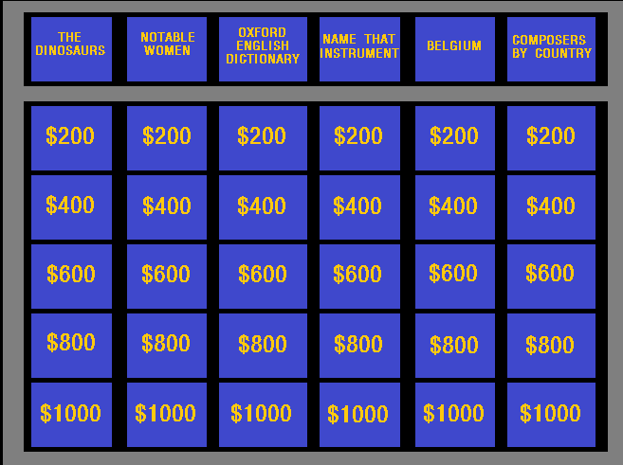
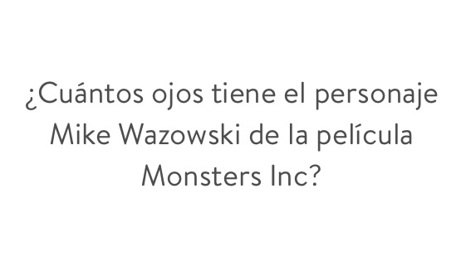
IBM Watson, Jeopardy! (Trivia) 2013

Slide 10
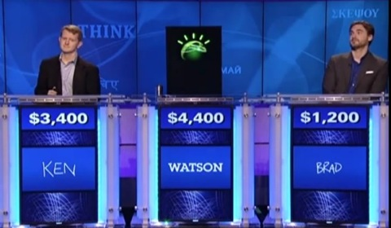
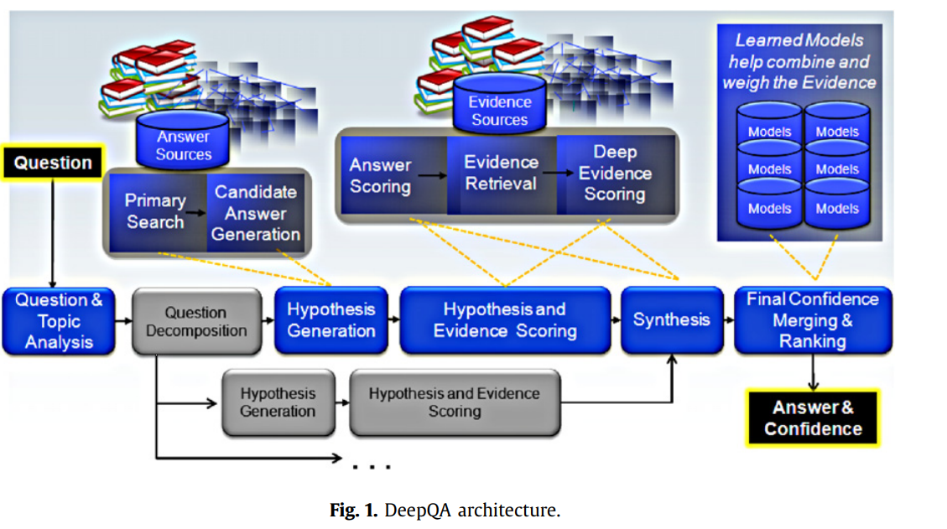
IBM Watson, Jeopardy! (Trivia)
Ferrucci, D., Levas, A., Bagchi, S., Gondek, D., & Mueller, E. T. (2013). Watson: beyond jeopardy!. Artificial Intelligence, 199, 93-105.

Slide 11
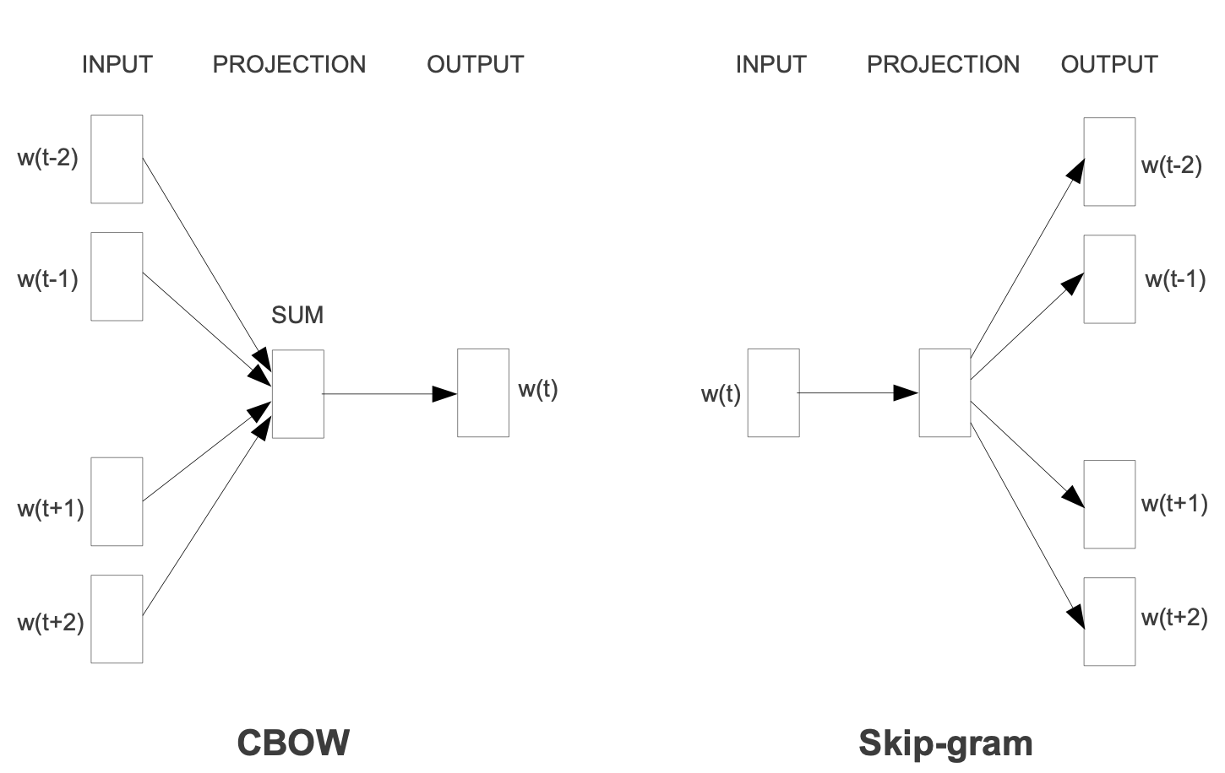
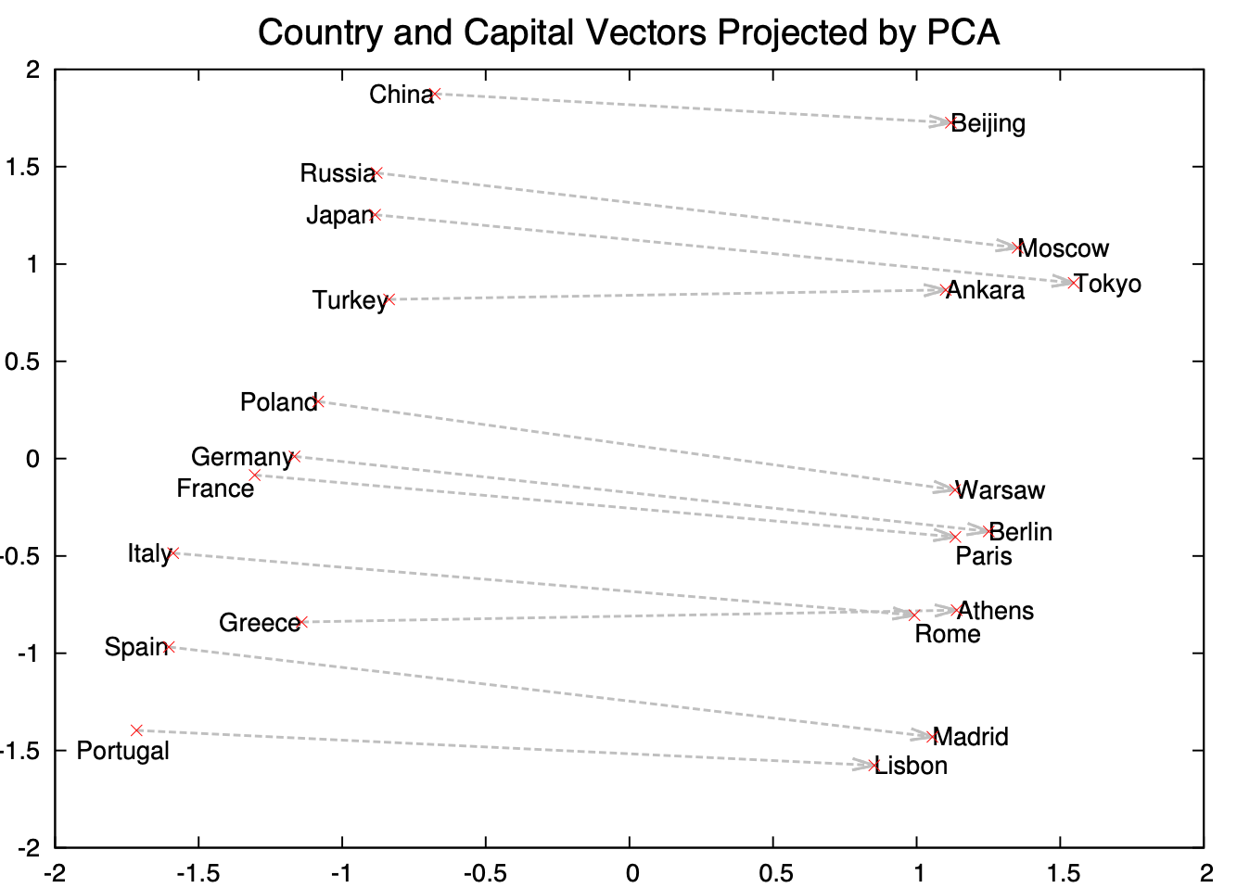
Embedding word2vec (Mikolov et al, 2013)
casa
0.1 | 0.2 | 0.3 | … | 0.1 | 0.1 | 0.05 | 0.1
Mikolov, T., Chen, K., Corrado, G., & Dean, J. (2013). Efficient estimation of word representations in vector space. arXiv preprint arXiv:1301.3781.
https://turbomaze.github.io/word2vecjson/

Slide 12
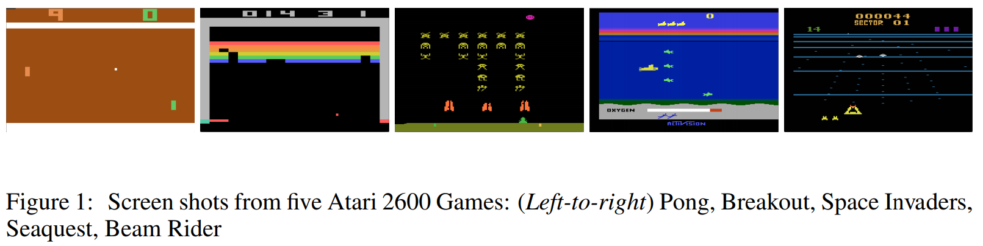
Google Deepmind: Jugar Atari, 210x160 RGB (60Hz) Reinforcement Learning + Q-Learning
Mnih, V., Kavukcuoglu, K., Silver, D., Rusu, A. A., Veness, J., Bellemare, M. G., ... & Petersen, S. (2015). Human-level control through deep reinforcement learning. Nature, 518(7540), 529.

Slide 13
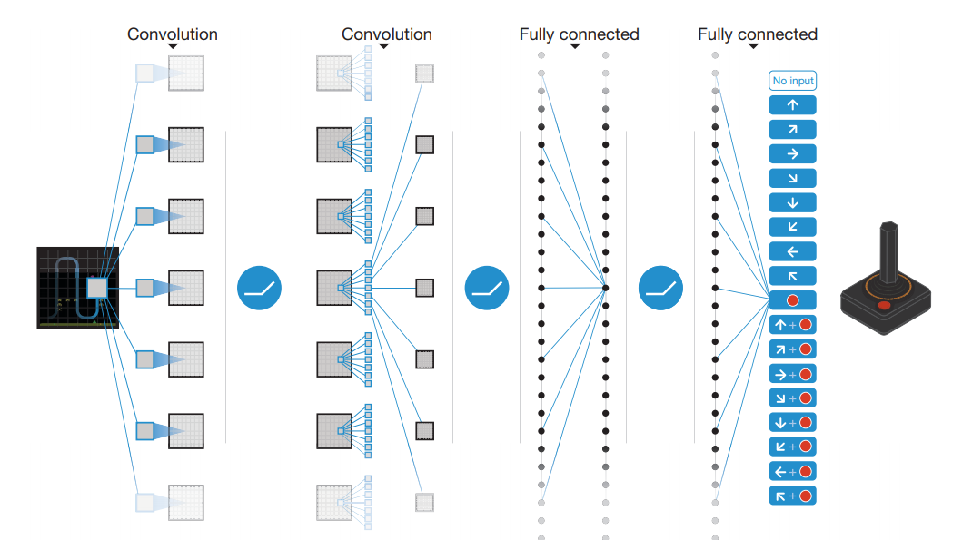
Google Deepmind: Jugar Atari, 210x160 RGB (60Hz) Reinforcement Learning + Q-Learning
Mnih, V., Kavukcuoglu, K., Silver, D., Rusu, A. A., Veness, J., Bellemare, M. G., ... & Petersen, S. (2015). Human-level control through deep reinforcement learning. Nature, 518(7540), 529.

Slide 14
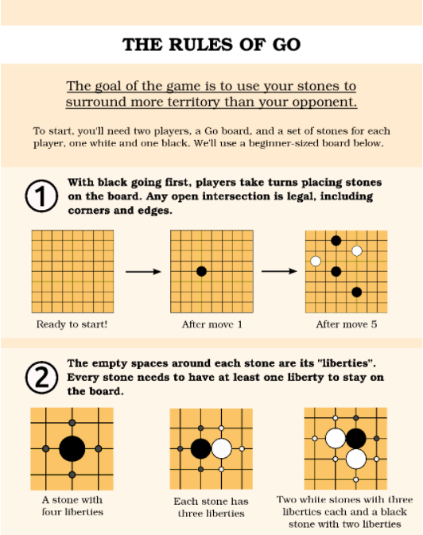
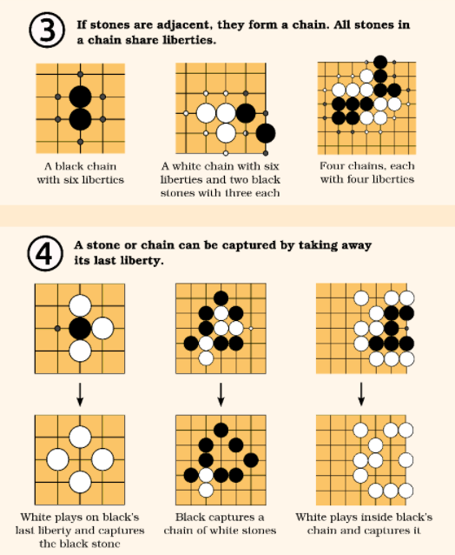
El juego del Go (China, 548 A. C.), tablero de 19x19 Estrategia compleja, movida inicial impacta hasta 100 pasos

Slide 15
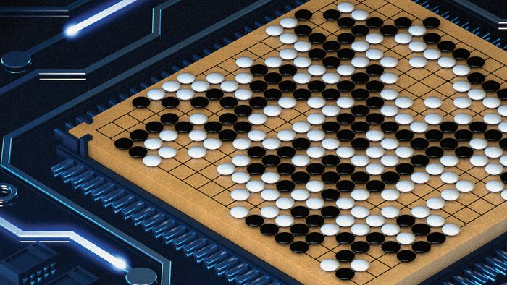
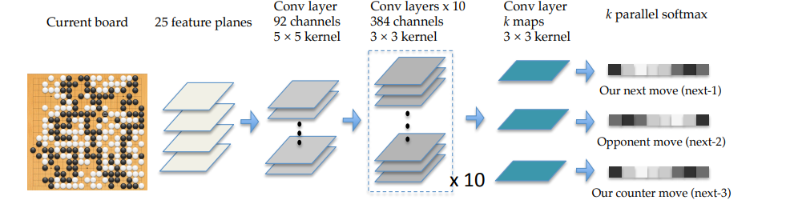
Google Deepmind: 2017 Alpha Go, 4-1 Lee Sedol

Slide 16
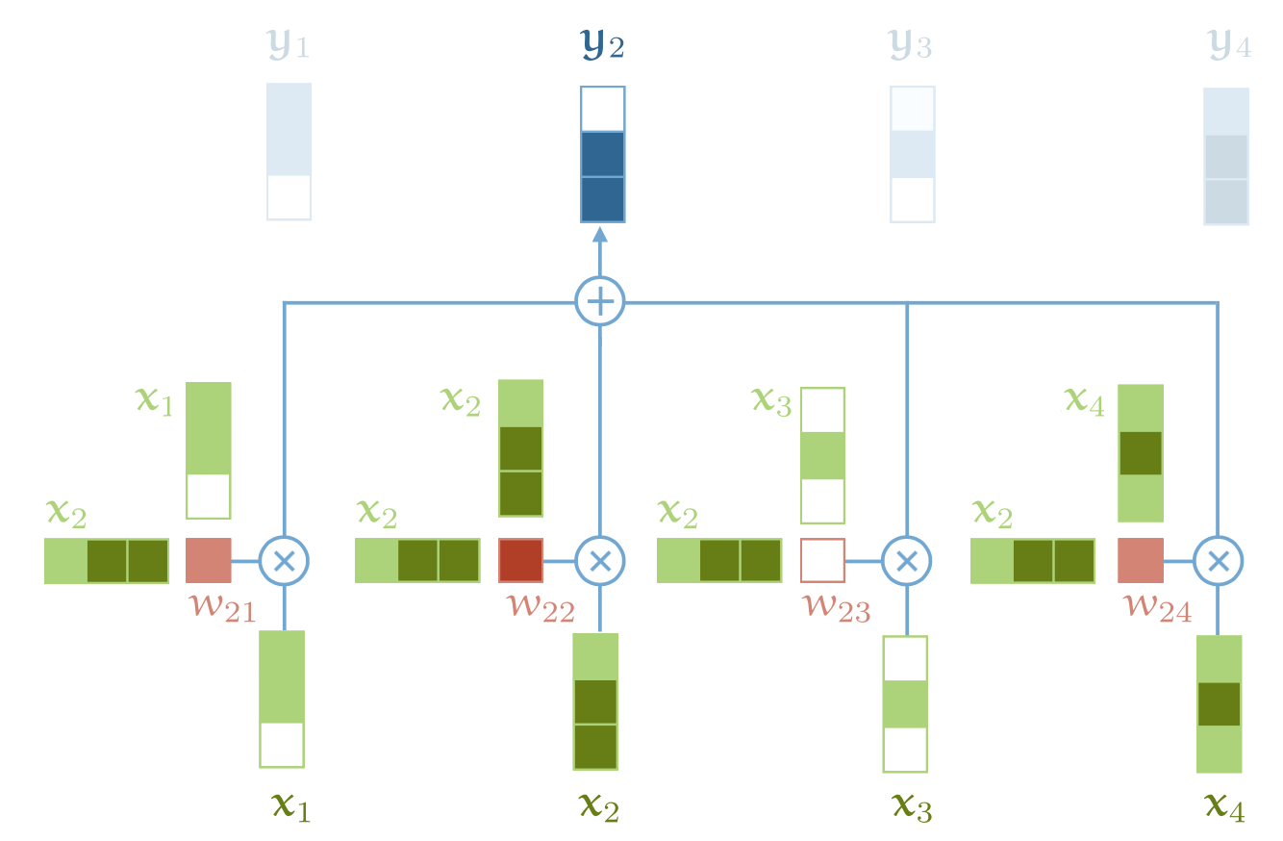
NLP, Transformers y Attention (Vaswani et al, 2017)
Self-attention head
Vaswani, A., Shazeer, N., Parmar, N., Uszkoreit, J., Jones, L., Gomez, A. N., ... & Polosukhin, I. (2017). Attention is all you need. Advances in neural information processing systems, 30.
http://peterbloem.nl/blog/transformers

Slide 17
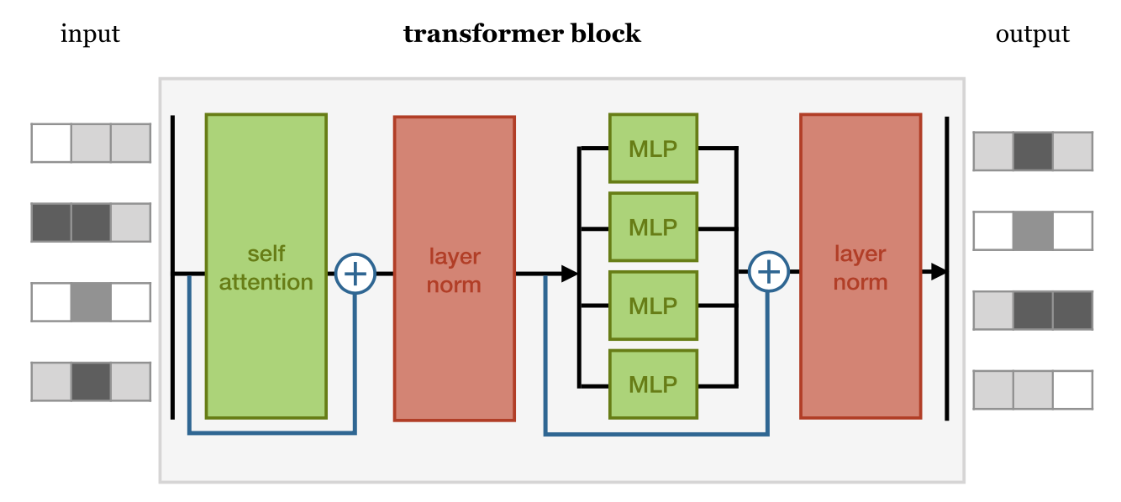
NLP, Transformers y Attention (Vaswani et al, 2017)
Vaswani, A., Shazeer, N., Parmar, N., Uszkoreit, J., Jones, L., Gomez, A. N., ... & Polosukhin, I. (2017). Attention is all you need. Advances in neural information processing systems, 30.
http://peterbloem.nl/blog/transformers

Slide 18
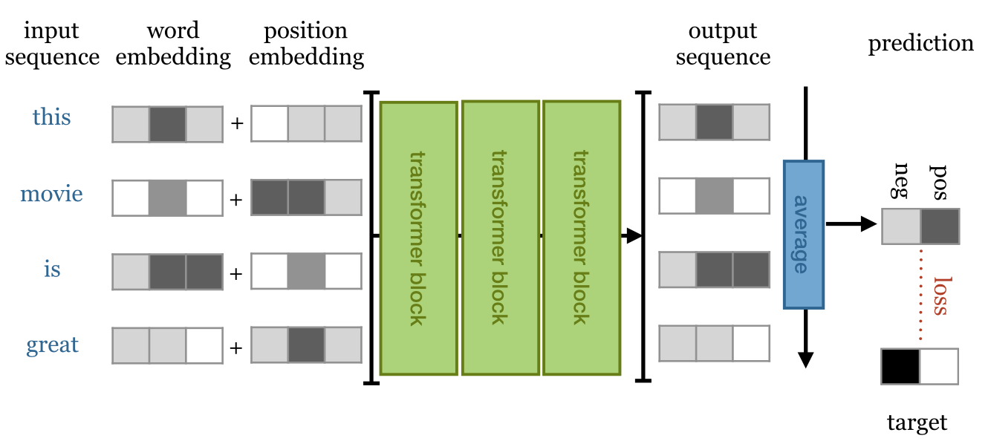
NLP, Transformers y Attention (Vaswani et al, 2017) Uso en clasificación
Vaswani, A., Shazeer, N., Parmar, N., Uszkoreit, J., Jones, L., Gomez, A. N., ... & Polosukhin, I. (2017). Attention is all you need. Advances in neural information processing systems, 30.
http://peterbloem.nl/blog/transformers

Slide 19
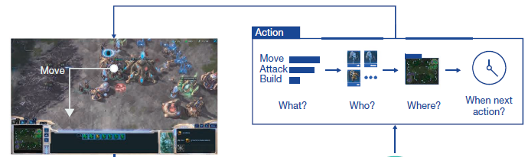
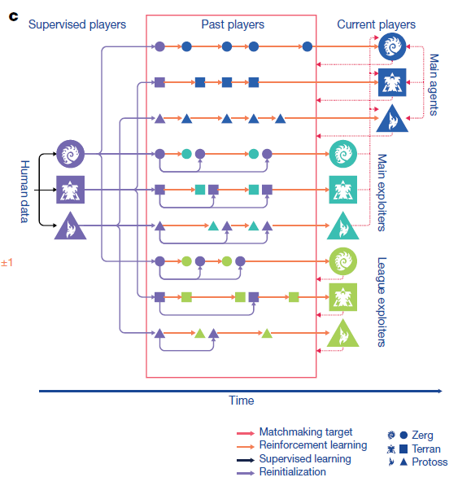
Deepmind, AlphaStar Octubre 2019 Grandmaster level in StarCraft II
Vinyals, O., Babuschkin, I., Czarnecki, W. M., Mathieu, M., Dudzik, A., Chung, J., ... & Oh, J. (2019). Grandmaster level in StarCraft II using multi-agent reinforcement learning. Nature, 575(7782), 350-354.
https://github.com/Blizzard/s2client-proto
https://github.com/deepmind/pysc2

Slide 20
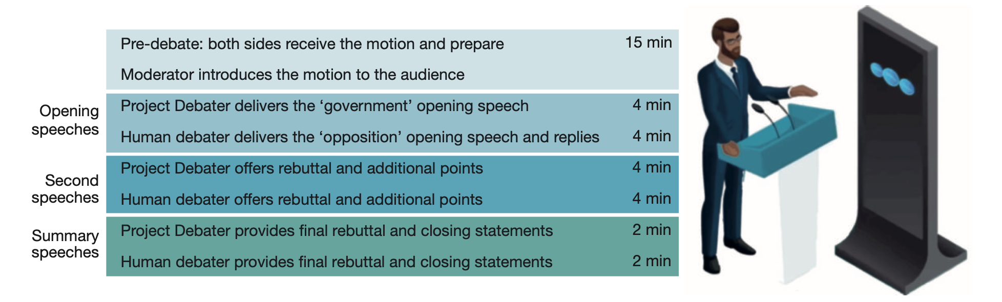
2021 IBM Project Debater
Slonim, N., Bilu, Y., Alzate, C. et al. An autonomous debating system. Nature 591, 379–384 (2021). https://doi.org/10.1038/s41586-021-03215-w
https://www.research.ibm.com/artificial-intelligence/project-debater/

Slide 21
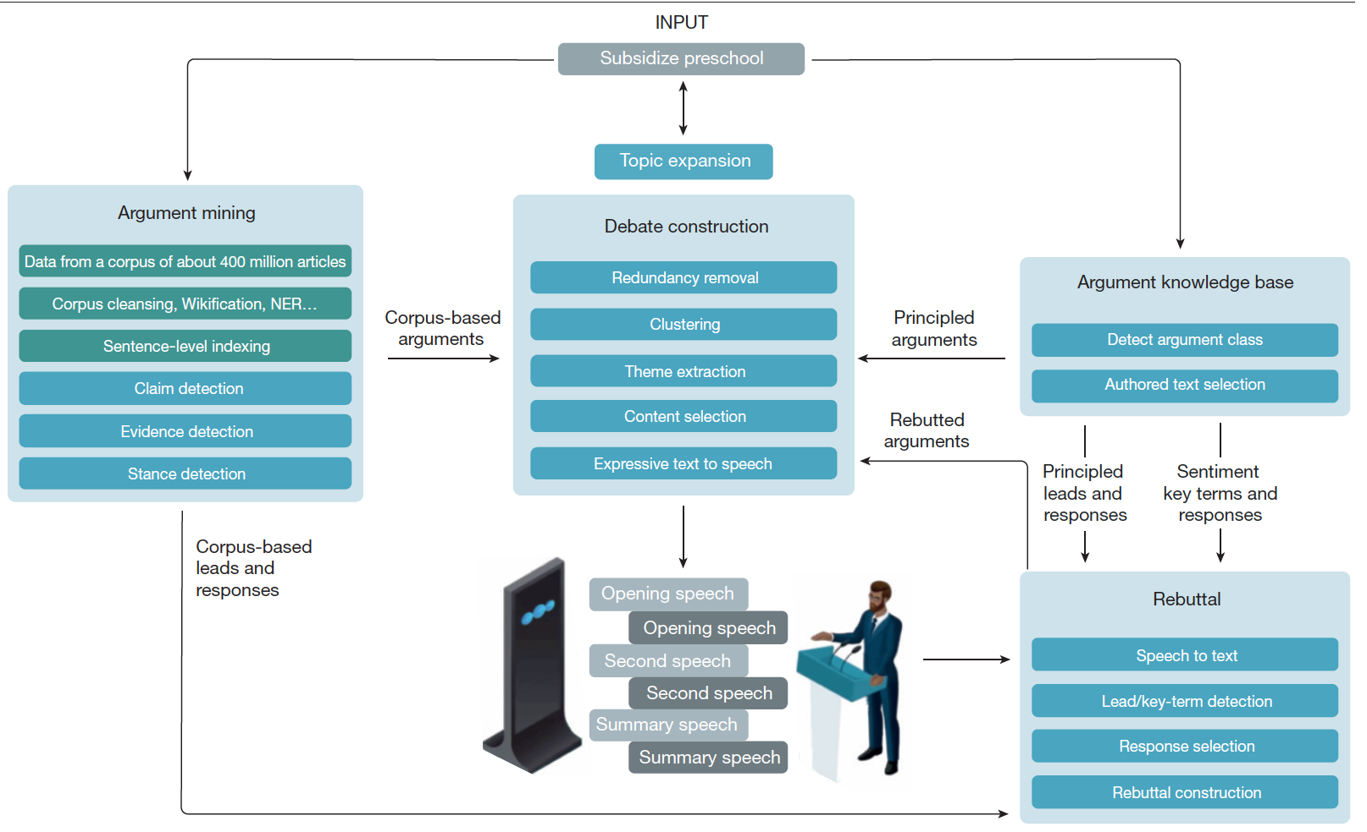
2021 IBM Project Debater
Slonim, N., Bilu, Y., Alzate, C. et al. An autonomous debating system. Nature 591, 379–384 (2021). https://doi.org/10.1038/s41586-021-03215-w

Slide 22
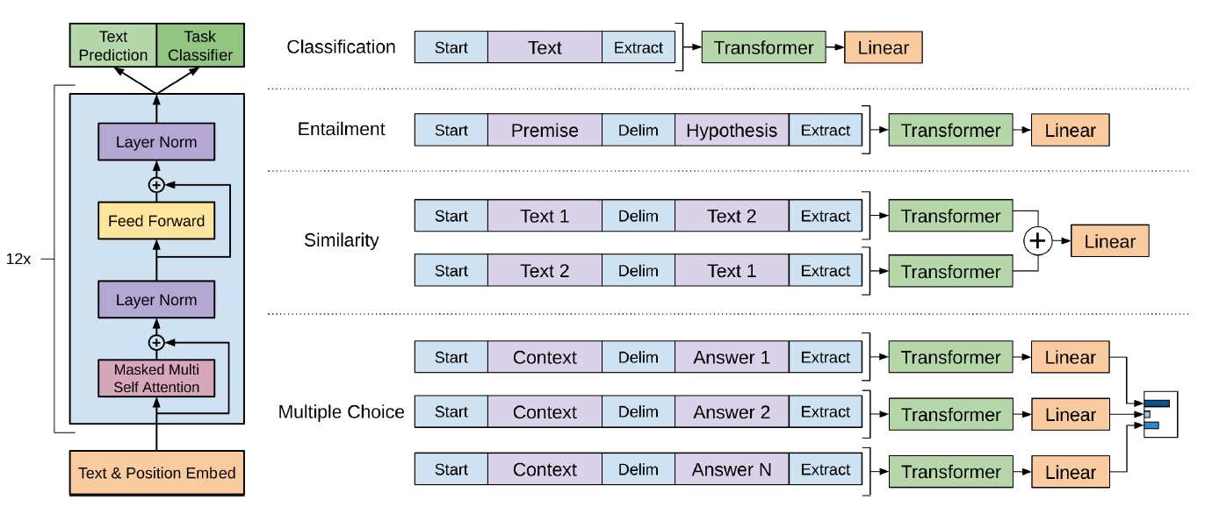
2018 GPT (Generative Pre-Trained Transformer) GPT-2 (2019), GPT-3 (2020), GPT-4 (2023)
Radford, A., Narasimhan, K., Salimans, T., & Sutskever, I. (2018). Improving language understanding by generative pre-training.
Radford, A., Wu, J., Child, R., Luan, D., Amodei, D., & Sutskever, I. (2019). Language models are unsupervised multitask learners. OpenAI blog, 1(8), 9.

Slide 23
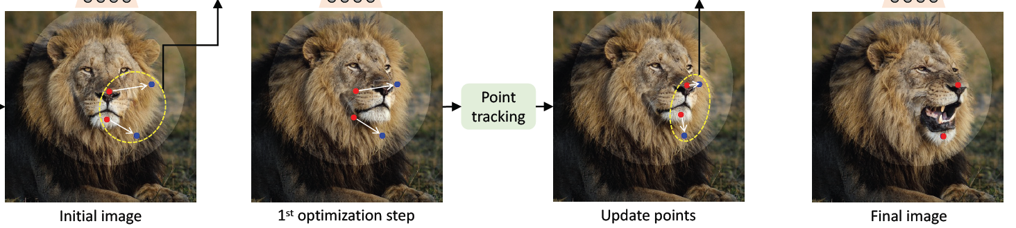
2023 Redes Generativas y Generación paramétrica de imágenes (GAN)
Pan, X., Tewari, A., Leimkühler, T., Liu, L., Meka, A., & Theobalt, C. (2023). Drag Your GAN: Interactive Point-based Manipulation on the Generative Image Manifold. arXiv preprint arXiv:2305.10973.

Slide 24
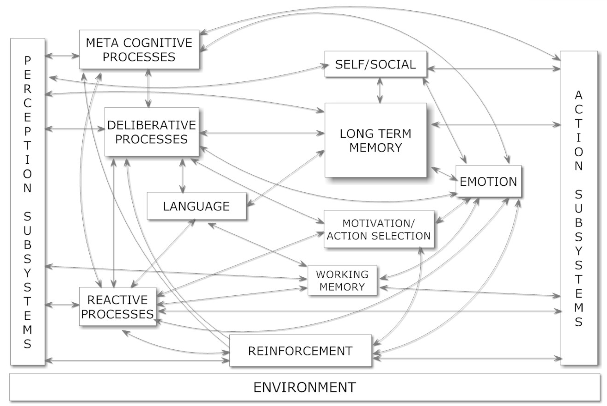
AGI (Artificial General Intelligence) 2023 y más allá
Schuett, J., Dreksler, N., Anderljung, M., McCaffary, D., Heim, L., Bluemke, E., & Garfinkel, B. (2023). Towards best practices in AGI safety and governance: A survey of expert opinion. arXiv preprint arXiv:2305.07153.
Xie, L., Wei, L., Zhang, X., Bi, K., Gu, X., Chang, J., & Tian, Q. (2023). Towards AGI in Computer Vision: Lessons Learned from GPT and Large Language Models. arXiv preprint arXiv:2306.08641.
Goertzel, B. (2007). Artificial general intelligence (Vol. 2, p. 1). C. Pennachin (Ed.). New York: Springer.

Slide 25
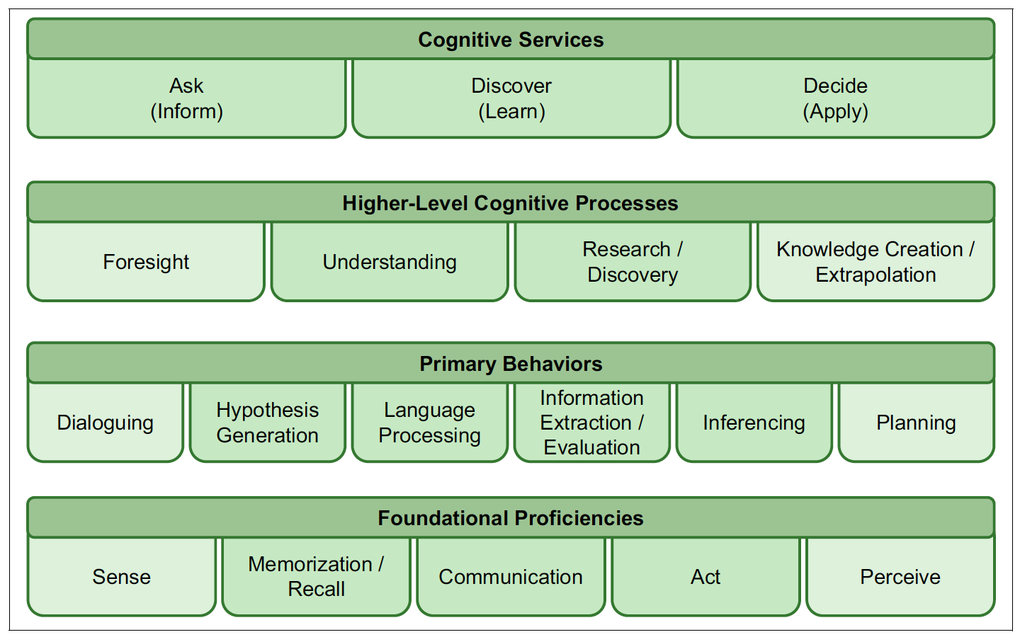
Elementos de un sistema cognitivo
Razonar
Aprender
Interactuar
Entender
Datos No Estructurados
Datos Estructurados
The Era of Cognitive Systems: An Inside Look at IBM Watson and How it Works

Slide 26

Preguntas
¡Muchas Gracias!

